Slide 1
Introduction to F#
Basics of Functional Programming

Slide 2
About the Speaker
Chang Hai Bin
B.Sc. (Math), NUS
M.Sc. (Math), University of Michigan
(Current) Financial Engineer, Numerical Technologies
(Previous) Business Analyst, US-Mattress

Slide 3
What is Functional Programming (FP)?
Based on combinatory logic
Uses functions to solve problem
  Functions as objects
  Higher Order Functions
Other Good Properties (depend on language)
  Purity/Type-check/Recursive/Lazy-evaluation/homoiconicity

Slide 4
FP Languages
Ancestor:
  ML (1973)
  Haskell (1990)
Cousins:
  OCaml(1996)
  Scala (2004)
  F# (2005)
  Elm (2012)
  ReasonML (2018)
Remark: Some also considers LISP (1958) and their dialects (e.g. Clojure 2007) functional languages.

Slide 5





Who uses FP?
Haskell
Clojure / F#
OCaml
Scala

Slide 6
Why Learn FP?
Concise code
Ability to reason
Unlock problems
Better Salary

Slide 7
This Talk: F#
(Statically Typed)
There are also Scala, Haskell, Clojure, Elm Meetups in Singapore.

Slide 8
Should I switch from C# to F#?
Early-adopter: Yes!
  Fun! Easy to Learn! Access other FP languages!
Normal-adopter: Yes.
  Use functional-technique in C# code.
Late-adopter/Skeptics: Maybe.
  A lot of new features in C# comes from F#.
  F# has better syntax to learn these concepts.

Slide 9
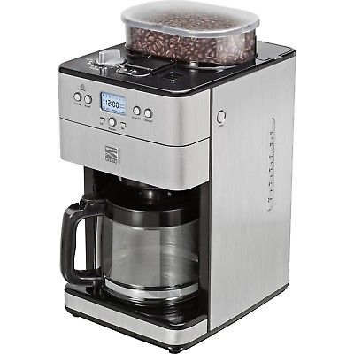
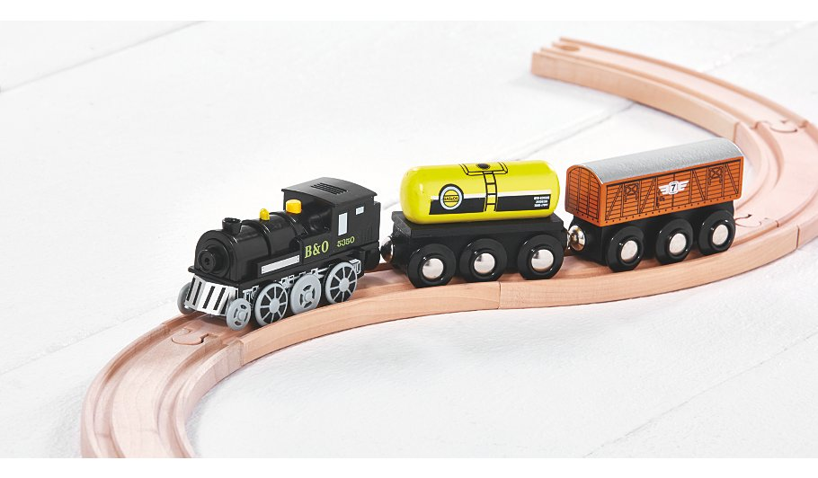

Core Concept
Functions are things
Compose functions

Slide 10
What is a function?
Function is a machine that take an input, and returns an output

Slide 11
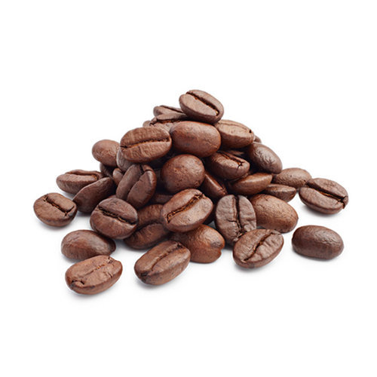
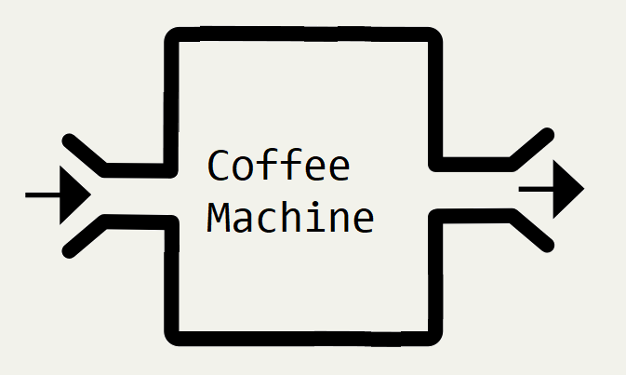


Slide 12


Slide 13


Slide 14


Slide 15
F# Example
let f x = x + 5
f 30 // 35
f 100 // 105

Slide 16
Notation
 | Math | F#
Define | let f(x) = x + 5 | let f x = x + 5
Use | f(100) | f 100

Slide 17
let f x = “Hello” + x
f “John” // “Hello John”
f “Jane” // “Hello Jane”

Slide 18
let f x = String.length x
f “Hello” // 5
f “Computer” // 8
f : string -> int

Slide 19
let f xs = List.sum xs
f [1..10] // 55
f [2;3;5;7;11] // 28
f : List<int> -> int

Slide 20
Multiple inputs
let f x y = x + y
f 2 3 // 5
f 30 70 // 100
f : int -> int -> int

Slide 21
Notation
 | Math | F#
Define | let f(x,y) = x + y | let f x y = x + y
Use | f(30, 70) | f 30 70

Slide 22
Multiple inputs
let f x y z = x + y + z
f 2 3 7 // 12
f 30 70 200 // 300
f : int -> int -> int -> int

Slide 23
Multiple inputs
let f a b c d = ......
f : A -> B -> C -> D -> output

Slide 24
Function Composition
Functions can be “connected” if the first output is the input of the second function.

Slide 25




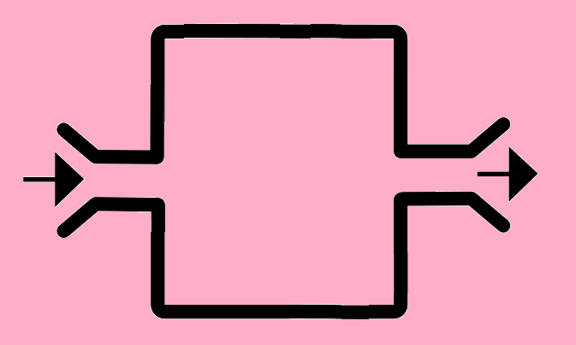

Slide 27

A bigger machine/function!
Banana is “hidden”

Slide 28
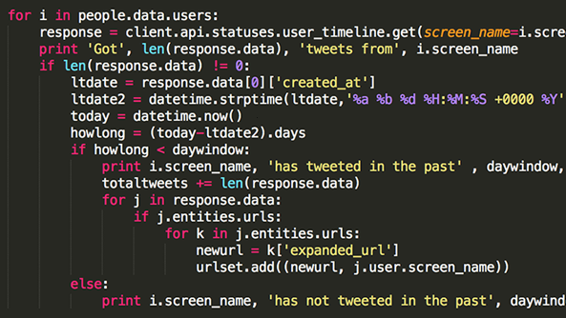

Coffee Machine
Programmer

Slide 29
Coffee Machine
Programmer

Slide 31
f : A -> B
g : B -> C
g (f a)
// = g ( b )
// = c

Slide 32
let f xs = List.sum xs
let g x =
if x > 80 then “A”
else if x > 60 then “B”
else “C”
f : List<int> -> int
g : int -> string

Slide 33
let f xs = List.sum xs
let g x =
if x > 80 then “A”
else if x > 60 then “B”
else “C”
g (f [20; 20; 50]) // g (90)
// “A”

Slide 34
Types must match
f : A -> B
g : C -> D
g (f a) ERROR!
Output of f not accepted by g

Slide 35
|>
Key idea in F#
Pipe-forward operator

Slide 36
What does pipe-forward do?
Change the order of the function and input

Slide 37
let f x = x + 5
f 100 // 105
100 |> f // 105

Slide 38
f : A -> B
g : B -> C
g (f a)
a |> f |> g

Slide 39
f : A -> B
g : B -> C
g (f a)
a
|> f
|> g

Slide 40
f : A -> B
g : B -> C
g (f a)
a
(then do) f
(then do) g

Slide 41
x
|> f
|> g
Start with input x,
Apply input to f,
Apply previous result to g.

Slide 42
x
|> f
|> g
|> h
Start with input x,
Apply input to f,
Apply previous result to g,
Apply previous result to h.

Slide 43
x
|> f
|> g
|> h
|> k
Start with input x,
Apply input to f,
Apply previous result to g,
Apply previous result to h,
Apply previous result to k.

Slide 44
x
|> f
|> g
|> h
|> k
Start with input x,
Apply input to f,
Apply previous result to g,
Apply previous result to h,
Apply previous result to k.
1st output = 2nd input
2nd output = 3rd input
etc.

Slide 45
x
|> f
|> g
|> h
|> k
In C#:
x.Pipe(f).Pipe(g).Pipe(h).Pipe(k);
You can do it in C#, but not as natural.

Slide 46
Benefit
Express Logic Step-by-Step
Easier to read

Slide 47
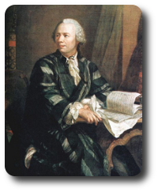

Example
Questions from Project Euler
https://projecteuler.net/

Slide 48
(Question 1) Find the sum of all the multiples of 3 or 5 below from 1 to 999.

Slide 49
(Question 1) Find the sum of all the multiples of 3 or 5 below from 1 to 999.
[1 .. 999]
|> List.filter (fun x -> x % 3 = 0 || x % 5 = 0)
|> List.sum

Slide 50
(Question 1) Find the sum of all the multiples of 3 or 5 below from 1 to 999.
[1 .. 999]
|> List.filter (fun x -> x % 3 = 0 || x % 5 = 0)
|> List.sum
Start with a list from 1 to 999
(then do) filter to keep the numbers you want
(then do) sum those remaining numbers.

Slide 51
(Question 1) Find the sum of all the multiples of 3 or 5 below from 1 to 999.
[1 .. 999]
|> List.filter (fun x -> x % 3 = 0 || x % 5 = 0)
|> List.sum
C# LINQ
Enumerable.Range(1, 999)
.Where(x => x % 3 == 0 || x % 5 == 0)
.Sum();

Slide 52
(Question 6 Modified)
Calculate 1² + 2² + ... + 100²

Slide 53
(Question 6 Modified)
Calculate 1² + 2² + ... + 100²
[1 .. 100]
|> List.map (fun x -> x * x)
|> List.sum

Slide 54
(Question 6 Modified)
Calculate 1² + 2² + ... + 100²
[1 .. 100]
|> List.map (fun x -> x * x)
|> List.sum
Start with a list from 1 to 100
(then do) convert each element to its square
(then do) sum up the previous list.

Slide 55
(Question 6 Modified)
Calculate 1² + 2² + ... + 100²
[1 .. 100]
|> List.map (fun x -> x * x)
|> List.sum
C# LINQ:
Enumerable.Range(1,100)
.Select(x => x * x)
.Sum();

Slide 56
(Additional Example)
Calculate Squares of Prime Numbers
Calculate 2² + 3² + 5² + 7² + 11² + 13² + 17² +... + 97²

Slide 57
(Additional Example)
Calculate Squares of Prime Numbers
Calculate 2² + 3² + 5² + 7² + 11² + 13² + 17² +... + 97²
[1 .. 100]
|> List.filter (fun x -> isPrime x)
|> List.map (fun x -> x * x)
|> List.sum
Need “isPrime”
Helper Function

Slide 58
Partial Application
Useful Language Design

Slide 59
let AddAll w x y z = w + x + y + z
let result = AddAll 1 2 3 4
// result = 10

Slide 60
let AddAll w x y z = w + x + y + z
let result = AddAll 1 2 3
// Missing one variable?

Slide 61
let AddAll w x y z = w + x + y + z
let result = AddAll 1 2 3
// No compilation error.
// result : int -> int

Slide 62
If a function/machine:
Needs 5 inputs
But only 2 inputs provided,
Still needs 3 additional inputs.

Slide 63
If a function/machine:
Needs 5 inputs
But only 2 inputs provided,
Becomes a brand new function/machine that needs 3 inputs.

Slide 64
let f u v w x y = ......
let result = f u v
// result : W -> X -> Y -> output

Slide 65
in C#
public static int Add (int x, int y){
return x + y;
}
Add(1);
Compile ERROR!

Slide 66
Special Case (n - 1)
f u v w a = b
g x y z b = c
f u v w : a -> b
g x y z : b -> c
a
|> f u v w
|> g x y z

Slide 67
Special Case (n - 1)
f u v w a = b
g x y z b = c
f u v w : a -> b
g x y z : b -> c
a
|> f u v w
|> g x y z
Assemble almost everything
except the final component

Slide 68
Special Case (n - 1)
[1 .. 100]
|> List.filter (fun x -> x % 3 = 0 || x % 5 = 0)
|> List.map (fun x -> x * x)
|> List.sum

Slide 69
Special Case (n - 1)
[1 .. 100]
|> List.filter (fun x -> x % 3 = 0 || x % 5 = 0)
|> List.map (fun x -> x * x)
|> List.sum
Assemble almost everything
except the final component

Slide 70
Special Case (n - 1) “this”
public static B1 f(this A1 a1, A2 a2, A3 a3){......}
public static C1 g(this B1 b1, B2 b2, B3 b3){......}
public static D1 h(this C1 c1, C2 c2, C3 c3){......}
f: A1,A2,A3 -> B1
g: B1,B2,B3 -> C1
h: C1,C2,C3 -> D1

Slide 71
Special Case (n - 1) “this”
a1
.f(a2,a3)
.g(b2,b3)
.h(c2,c3);
f: A1,A2,A3 -> B1
g: B1,B2,B3 -> C1
h: C1,C2,C3 -> D1

Slide 72
a1
.f(a2,a3)
.g(b2,b3)
.h(c2,c3);
f(a1,a2,a3)
.g(b2,b3)
.h(c2,c3);
h(g(f(a1,a2,a3),b2,b3),c2,c3);
g(f(a1,a2,a3),b2,b3)
.h(c2,c3);

Slide 73
“Currying”
Func<A, Func<B,Func<C,Func<D,Z>>>>
Flexible
Func<A,B,C,D,Z>
Not flexible (need to assemble everything)

Slide 74
Func<A, Func<B,Func<C,Func<D,Z>>>>
Func<A, Func<B,Func<C,Func<D,Z>>>>
Func<A, Func<B,Func<C,Func<D,Z>>>>
Func<A, Func<B,Func<C,Func<D,Z>>>>

Slide 75
“Currying”
Func<A, Func<B,Func<C,Func<D,Z>>>> Curry (Func<A,B,C,D,Z> f) {
return a => b => c => d => f(a,b,c,d);
}
var g = Curry(f);
g(a) Compiles!
g(a)(b) Compiles!
g(a)(b)(c) Compiles!

Slide 76
Higher Order Functions

Slide 77
Primitive Types
public double f(double a, int b, string c){......}
Basic data types as inputs/outputs

Slide 78
Functions as input
public double f(Func<double,int> g, string c){......}
Function “f” accepts another function “g” as input.

Slide 79
Functions as output
public Func<int,double> f(double a, int b, string c){......}
Function “f” returns another function as output.

Slide 80
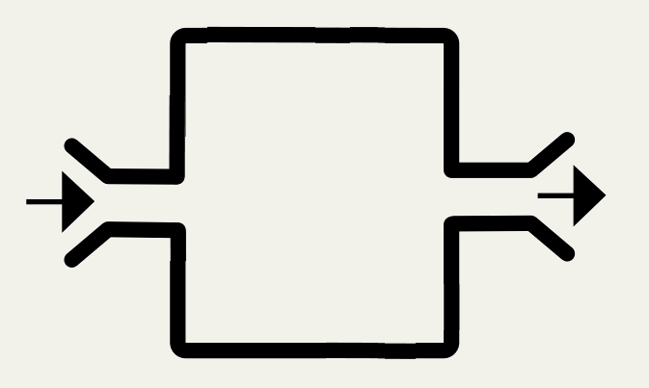



Slide 81
filter, map
[1 .. 999]
|> List.filter (fun x -> x % 3 = 0 || x % 5 = 0)
|> List.sum
[1 .. 100]
|> List.map (fun x -> x * x)
|> List.sum

Slide 82
Filter
let filter f xs = ......
(X -> bool) -> List<X> -> List<X>
List<X> filter(Func<X,bool> f, List<X> xs)
LINQ.Where

Slide 83
Map
let map f xs = ......
(X -> Y) -> List<X> -> List<Y>
List<Y> map(Func<X,Y> f, List<X> xs)
LINQ.Select

Slide 84
Strategy Pattern
public class Package{
private IShippingStrategy iShippingMethod;
public double postalCost(Order order){
return iShippingMethod.Calculate(order);
}
}
public class FedexStrategy : IShippingStrategy{
public double iShippingMethod.Calculate(....)
{......}
}

Slide 85
public class Package{
private IShippingStrategy iShippingMethod;
public double postalCost(Order order){
return iShippingMethod.Calculate(order);
}
}
iShippingMethod.Calculate:
Order -> double

Slide 86
public class Package{
private Func<Order,double> iShippingMethod;
public double postalCost(Order order){
return iShippingMethod(order);
}
}

Slide 87
public class Package{
public double postalCost(Order order,
Func<Order, double> iShippingMethod)
{
return iShippingMethod(order);
}
}

Slide 88
public double postalCost(Order order,
Func<Order, double> iShippingMethod)
{
return iShippingMethod(order);
}

Slide 89
public double postalCost(Order order,
Func<Order, double> f)
{
return f(order);
}

Slide 90
public double postalCost(A a,
Func<A, double> f)
{
return f(a);
}

Slide 91
public B postalCost(A a,
Func<A, B> f)
{
return f(a);
}

Slide 92
public B postalCost(A a, Func<A, B> f)
{ return f(a); }

Slide 93
public B postalCost(A a, Func<A, B> f)
{ return f(a); }
postalCost a f = f a

Slide 94
postalCost a f = f a

Slide 95
postalCost a f = f a
(|>) a f = f a

Slide 96
Insurance Pricing Example

Slide 97
Summary of Tricks
Chain/pipe functions as much as possible.
Use partial application for get a new function.
  “this” keyword for special case (n-1)
Higher order functions.
  Use Functions as inputs and outputs.

Slide 98
Learn more about F#

Slide 99
What to learn next in F#?
Sets, Lists, Dictionary
Pattern Matching
Union Type, Tuples, Records
Option Type (Missing/null Values)
Async
Impure Operations

Slide 100
Where to learn?
FSharpforfunandprofit blog
  https://fsharpforfunandprofit.com/
Real-World Functional Programming
  https://www.manning.com/books/real-world-functional-programming

Slide 101
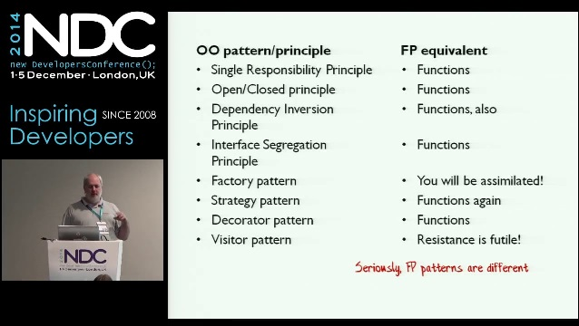
Conference videos?
Scott Wlaschin (author for F#forfunandprofit)
  Great tech educator.
  Given many good talks during NDC Conference. (Available on Youtube)

Slide 102
How to learn?
Try out Project Euler Questions.
Tips and tricks here:
https://fsharpforfunandprofit.com/learning-fsharp/
I have some training materials for interns.

Slide 103
Sources (Who uses FP)
https://www.janestreet.com/technology/
https://reasonml.github.io/
https://fsharp.org/testimonials/
https://devblogs.nvidia.com/jet-gpu-powered-fulfillment/
https://www.scala-lang.org/old/node/1658
https://clojure.org/community/companies
https://www.slideshare.net/naughty_dog/statebased-scripting-in-uncharted-2-among-thieves

